Slide 1


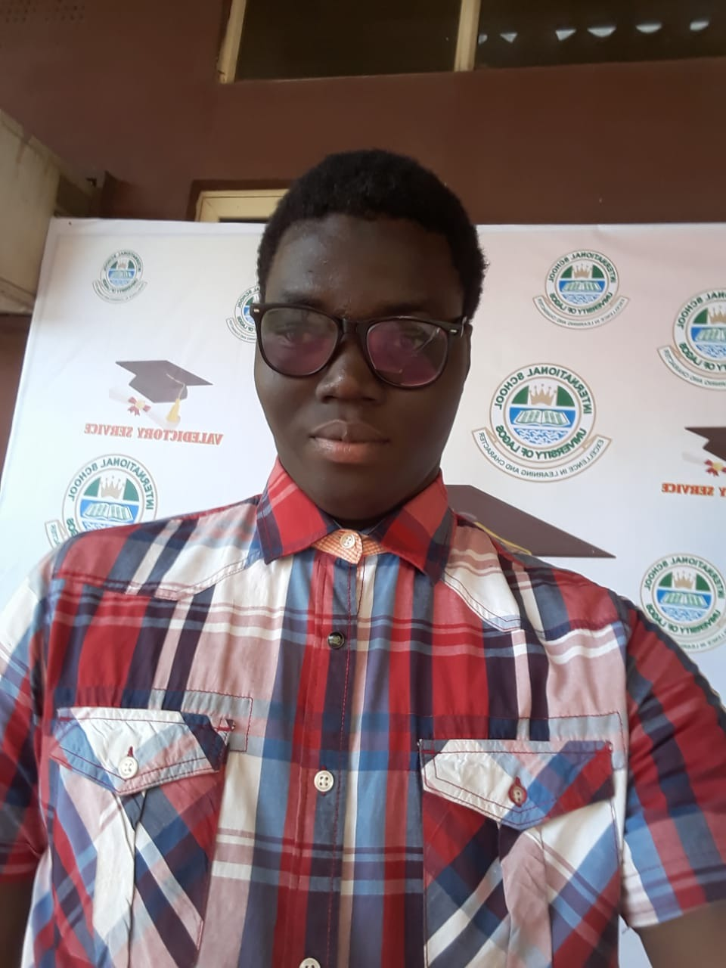

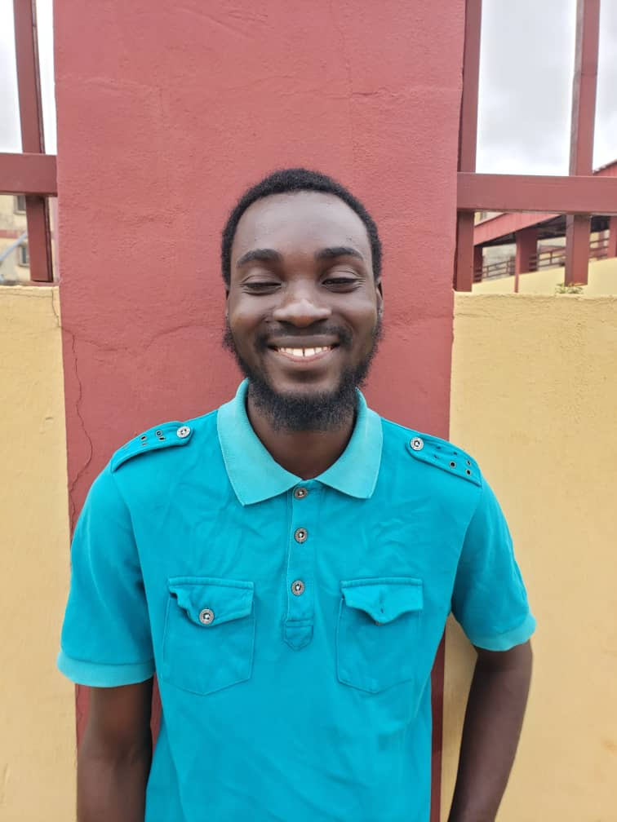
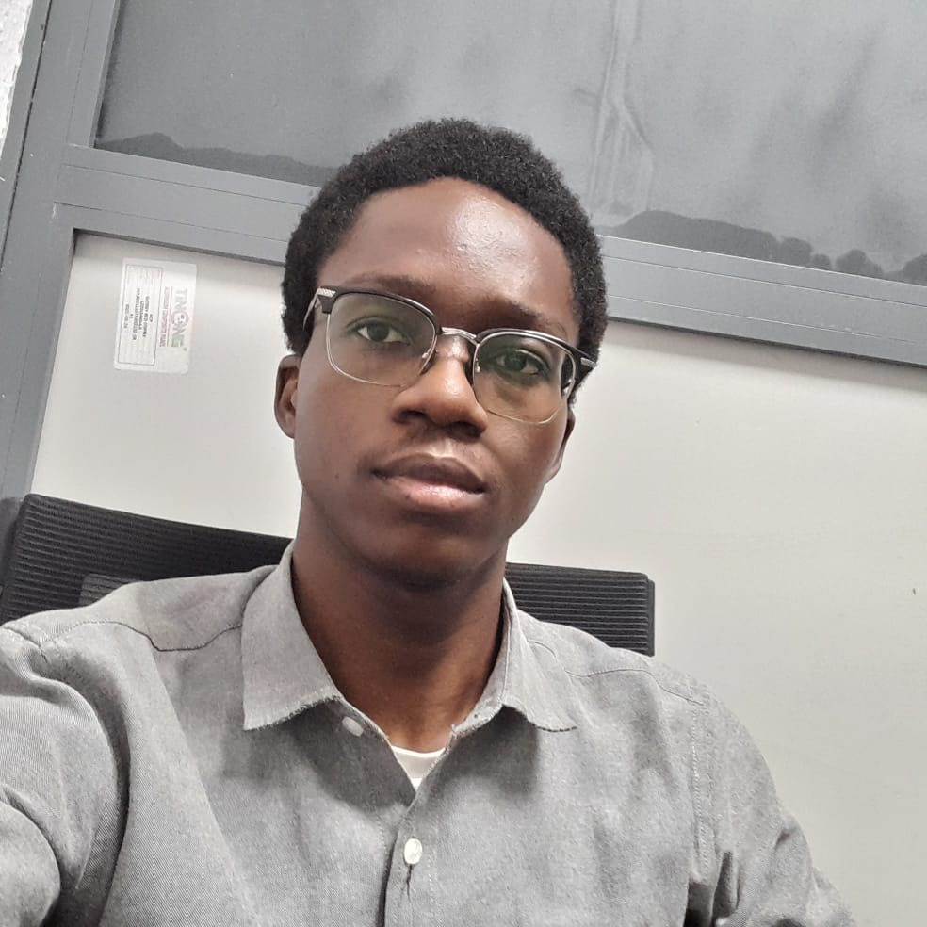
Fingerprint Biometric Attendance System
Team B - Innovative
Major Contributor:
Hamid-Mosaku Ahmad Oluwaseun
University of Lagos
Systems Engineering
Year 2
Olowoyobiojo Sodiq Adekolade
University of Lagos
Petroleum and Gas Engineering
Year 1
Adewole Benard University of Lagos
Systems Engineering
Year 5

Slide 2
Table of Content
Summary of the project
Motivation for the project
Problem Statement
Methods used to achieve solution
Problems encountered in the project
Project Advancement
Commercialization

Slide 3


Summary of the project
This is a biometric attendance-based system where students can easily register their attendance instead of pen and paper attendance.
It prevents ghost students/workers in a system.
It's makes attendance easier and convenient for both the lecturers and students. This is part of the issues we face in the classroom, and this project serves as a remedy

Slide 4

Motivation for the project
The motivation for this project is to create an attendance system where can easily take their attendance without much stress. It can be used in a classroom and in other places too.
For example, in a classroom whereby we have a lot of student, this system would be useful as a lot of students can be recorded in a very short time (that is attendance made easy). Then other than the classroom, this system can be used department office or any other place where people come in and out.

Slide 5

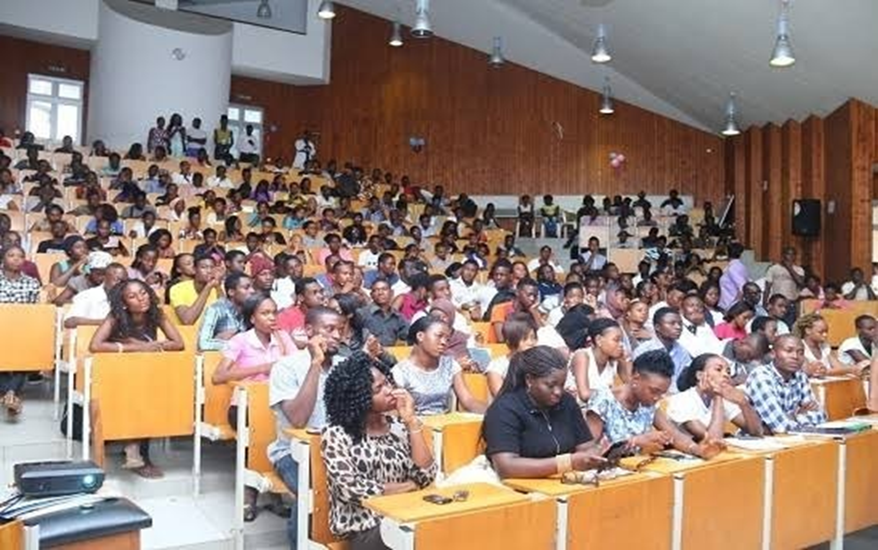
Problem Statement
Ghost students/workers in a system
Multiple attendance sheets. Large pile for lecturers and Employee to keep account of.
Missing attendance sheets
Time Consumption for attendance
Difficulty experienced while taking written attendance

Slide 6
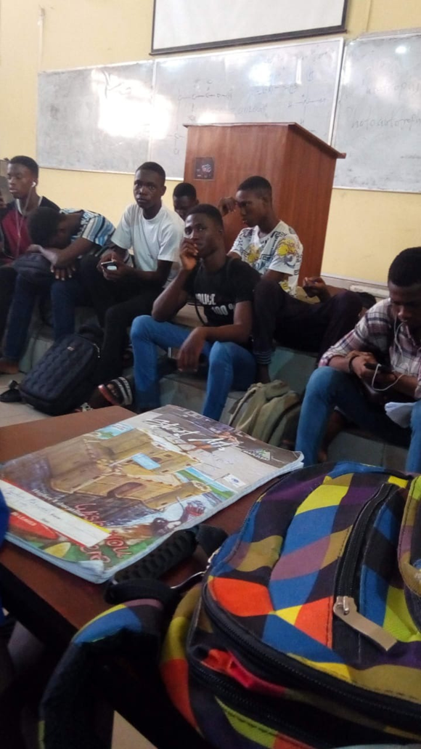
Problem Statement
During my first year as an undergraduate student of UNILAG, we often had lectures at DLI, with over 1000 students present in the hall. Seats were never sufficient, let alone to consider taking attendance of that large population of students.
The rowdy behaviors of students when it comes to taking attendance almost makes the classroom a marketplace.
Sometimes attendance sheets get missing, some sheets may not be submitted to the lecturers, and the lecturer would have to keep a large pile of these sheets

Slide 7
Methods used to achieve solution
Basic knowledge of electronics
Basic programming skills
Engineering design thinking
Critical thinking
Teamwork

Slide 8
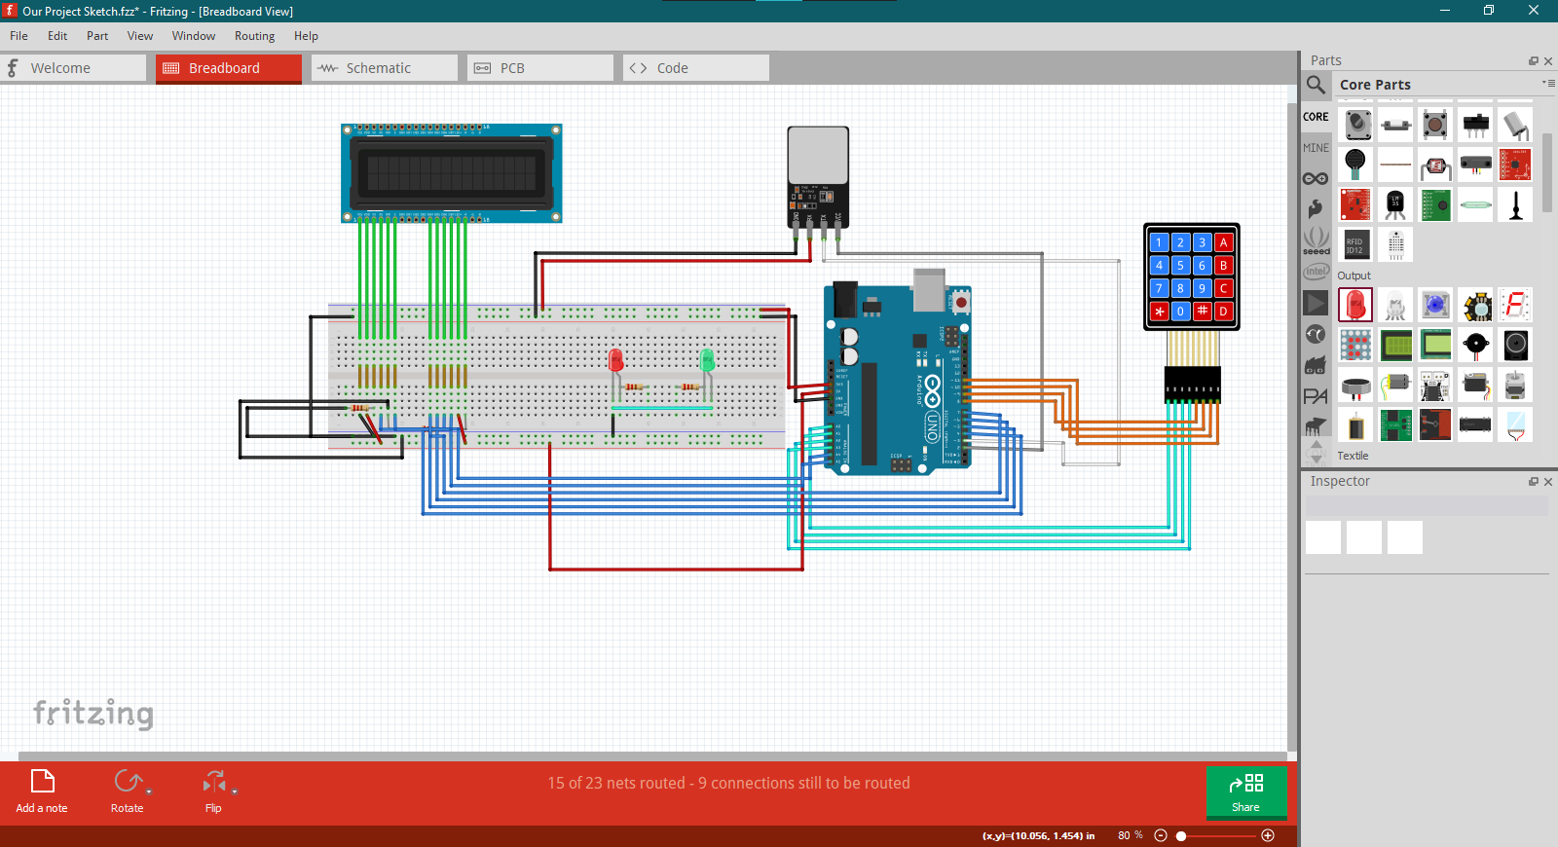
THE ELECTRIC DESIGN OF THE PROJECT

Slide 9
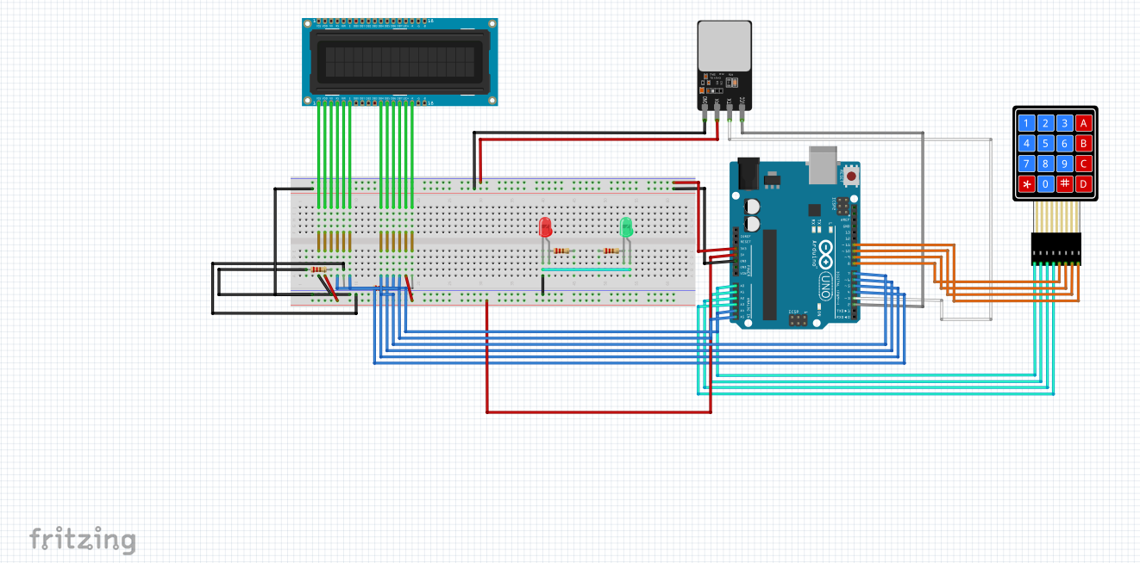

Slide 10
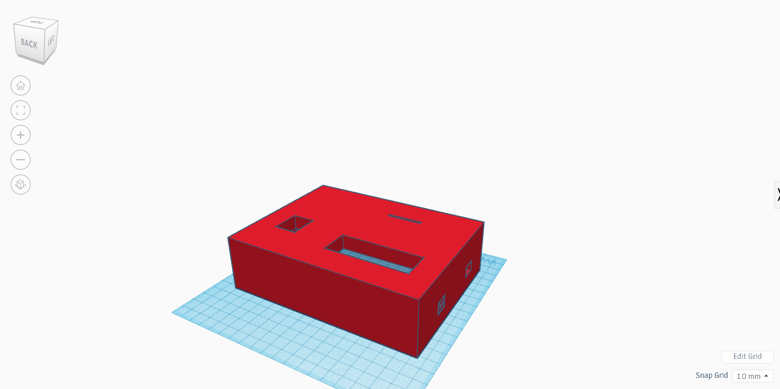
CASE CONSIDERED FOR THE PROJECT

Slide 11
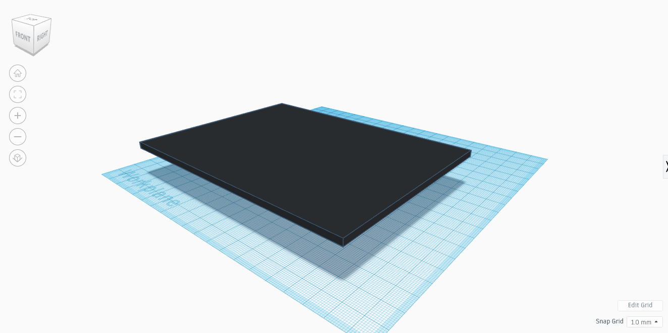
CASE CONSIDERED FOR THE PROJECT

Slide 12




Problems Encountered
Team members commitment
Fingerprint sensor damage
Lack of funds
Technical know how

Slide 13
Project Advancement
Build a web-based system for user information management
Get sophisticated hardware, with internet connection
More research
Data Insight e.g student average attendance

Slide 14
Commercialization
This project can be sold to schools, universities and corporate workspaces. It can also be used in any gathering that may require user identification

Slide 15
Thank You
z

